Slide 1
Getting Ready for Erie Gives Using Canva!
Amanda Karns
Dorado Creative
814-403-7576
doradocreative@gmail.com

Slide 2
Today’s Goals
Crash course in branding and color guidelines
Getting comfortable with Canva basics through a guided tour
Hands-on practice using your new Canva account

Slide 3
What are the basic branding rules for your organization?
Who/what agency made your logo?
What is their contact information? !
What is the official name you’ll use with the public?
Are there acronyms?
What is your tagline & what are the rules for when it’s used?

Slide 4
Understanding Colors
COLORS – consider fonts, logos, backgrounds, etc.
There are four main categories used in design projects, depending on what the application is:
HEX Codes
CMYK Colors (for print)
RGB (for screen)
Pantone (PMS) swatches

Slide 5
Hex Codes – colors on the web
“Hex,” of course, means SIX. Hex codes are 6 letters/digits used primarily in web design
Helpful to know when you’re using online programs like Canva
Makes it quick and easy to find the EXACT color, especially when you can’t trust your monitor.
There are online color pickers that can show you an image’s hex code

Slide 6
Worksheet Questions
What colors are in the Erie Gives logo (hex codes)?
What colors are in your organization’s logo (hex codes)?
What are some complementary colors you could use to make your logo stand out?

Slide 7
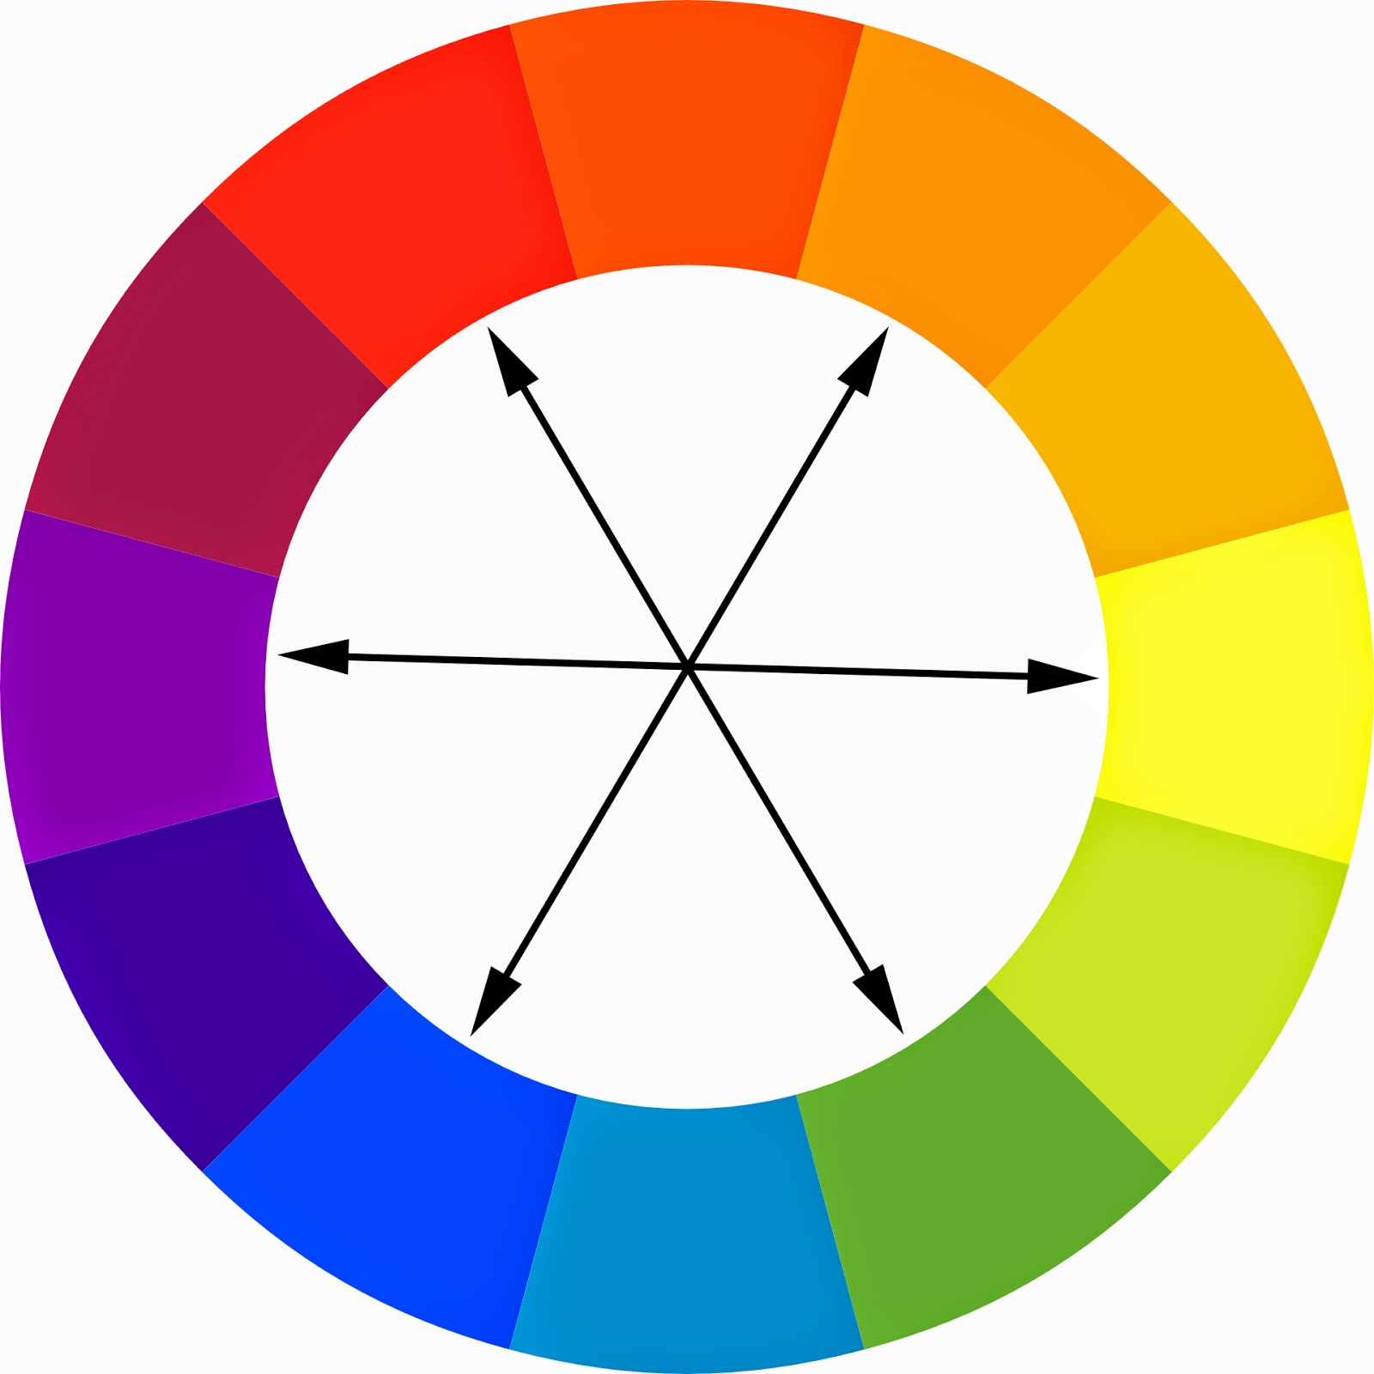

Slide 8
Fonts: PICK and STICK!
Include notes on applicable colors and point sizes, and how they should relate to each other proportionately
Name/examples of title, header & body fonts
When and how to use italics/bold body styles
Actual font files with licenses should go in the shared folder

Slide 9
Worksheet Questions
What font(s) will you use in your Erie Gives materials? (Headings, Sub-Headings, Body)
Does your organization already have existing examples of this?
https://designschool.canva.com/blog/the-ultimate-guide-to-font-pairing/

Slide 10
